Slide 1

A Hope for Israel in the Early Church?
Notes:
“”

Slide 2

A Hope for Israel in the Early Church?
fathersonthefuture.com/resources/
Notes:
“”

Slide 3

A Hope for Israel in the Early Church?
Notes:
“”

Slide 4
A Hope for Israel in the Early Church?
New Creation Premill—“Millennium” is symbol for New Creation; no future for Israel, only immortals
Spiritual Premill—“Millennium” is distinct from New Creation, but occupied only by immortals
Incarnational Premill—“Millennium” is first phase of eternal kingdom, with mortals and immortals, usually with distinct nation of Israel centered in Jerusalem
Jewish-Christian Premill—“Millennium” focused on restoration of Israel, with temple, sacrifices, and feasts
Carnal Premillennialism—“Millennium” is party time for resurrected saints to indulge in carnal pleasures
Notes:
“”

Slide 5
A Hope for Israel in the Early Church?
1st Century
2nd Century
3rd Century
Earthly Kingdom &
Restoration of Israel
Earthly Kingdom Centered in Jerusalem
& Subtle Refences to Restoration of Israel
Jewish-Christian Premillennialism
Gentile Christian
Premillennialism
Gentile Christian
Amillennialism
No Earthly Kingdom, No Rebuilding of Jerusalem,
& No Restoration of Israel, though Sometimes a Future Conversion of Jews
Notes:
“”

Slide 6
A Hope for Israel in the Early Church?
Testaments of the Twelve Patriarchs (1-2 c.)
Justin Martyr (2 c.)
Irenaeus of Lyons (2 c.)
Tertullian (2-3 c.)
Nepos of Arsinoe (3 c.)
Victorinus of Pettau (3 c.)
Notes:
“”

Slide 7
A Hope for Israel in the Early Church?
1st Century
2nd Century
3rd Century
Earthly Kingdom &
Restoration of Israel
Jewish-Christian Premillennialism
Notes:
“”

Slide 8
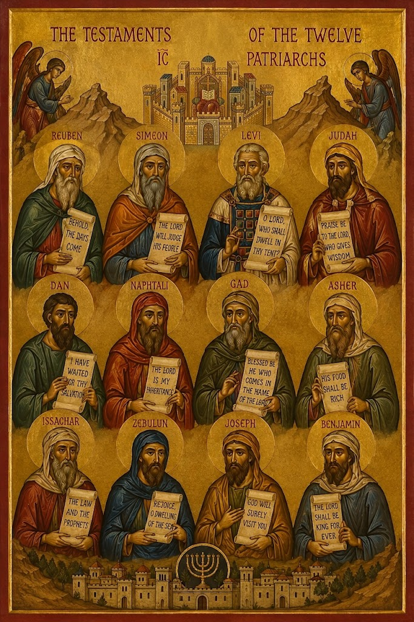
A Hope for Israel in the Early Church?
Testament of the Twelve Patriarchs (AD 2d C.)
“The Testaments of the Twelve Patriarchs are the fictional valedictory speeches of the sons of Jacob. Completed sometime in the first two centuries of the Common Era, they consist of autobiography, exhortation and prediction.”
Robert Kugler, The Testaments of the Twelve Patriarchs, Guides to the Apocrypha and Pseudepigrapha (Sheffield, U.K.: Sheffield Academic, 2001), 11.
Notes:
“”

Slide 9
A Hope for Israel in the Early Church?
Testament of the Twelve Patriarchs (AD 2d C.)
“And your holy places shall be laid waste even to the ground because of him. And ye shall have no place that is clean; but ye shall be among the Gentiles a curse and a dispersion until He shall again visit you (ἕως αὐτος πάλιν ἐπισκέψηται), and in pity shall receive you through faith and water.” (Test. Levi 16.4–5)
Notes:
“”

Slide 10
A Hope for Israel in the Early Church?
Testament of the Twelve Patriarchs (AD 2d C.)
“And the Lord shall bring upon them divisions one against another, and there shall be continual wars in Israel; and among men of other race shall my kingdom be brought to an end, until the salvation of Israel shall come, until the appearing of the God of righteousness, that Jacob and all the Gentiles may rest in peace. And he shall guard the might of my kingdom for ever: for the Lord sware to me with an oath that the kingdom should never fail from me, and from my seed for all days, even for ever.” (Test. Judah 22; cf. Rom 11:25–26)
Notes:
“”

Slide 11
A Hope for Israel in the Early Church?
Testament of the Twelve Patriarchs (AD 2d C.)
“And after these things shall a star arise to you from Jacob in peace, and a man shall arise from my seed, like the sun of righteousness, walking with the sons of men in meekness and righteousness; and no sin shall be found in him. And the heavens shall be opened unto him, to pour out the spirit, (even) the blessing of the Holy Father; and He shall pour out the spirit of grace upon you; and ye shall be unto Him sons in truth, and ye shall walk in His commandments first and last,…
Notes:
“”

Slide 12
A Hope for Israel in the Early Church?
Testament of the Twelve Patriarchs (AD 2d C.)
“…this Branch of God Most High, and this Fountain giving life unto all. Then shall the sceptre of my kingdom shine forth; and from your root shall arise a stem; and from it shall grow a rod of righteousness to the Gentiles, to judge and to save all that call upon the Lord.”
(Test. Judah 24.1–6)
Notes:
“”

Slide 13
A Hope for Israel in the Early Church?
Testament of the Twelve Patriarchs (AD 2d C.)
“And after these things shall Abraham and Isaac and Jacob arise unto life, and I and my brethren shall be chiefs of the tribes of Israel… And ye shall be the people of the Lord, and have one tongue; and there shall be there no spirit of deceit of Beliar, for he shall be cast into the fire for ever. And they who have died in grief shall arise in joy, and they who were poor for the Lord’s sake shall be made rich, and they who are put to death for the Lord’s sake shall awake to life.”
(Test. Judah 25.1, 3–4)
Notes:
“”

Slide 14
A Hope for Israel in the Early Church?
Testament of the Twelve Patriarchs (AD 2d C.)
“And forsaking the commandments of the Lord, they will cleave unto Beliar. And leaving husbandry, they will follow after their own wicked devices, and they shall be dispersed among the Gentiles, and shall serve their enemies. And do you therefore give these commands to your children, that, if they sin, they may the more quickly return to the Lord; for He is merciful, and will deliver them, even to bring them back into their land.”
(Test. Issa. 6.1–3)
Notes:
“”

Slide 15
A Hope for Israel in the Early Church?
Testament of the Twelve Patriarchs (AD 2d C.)
“And again through the wickedness of your works shall ye provoke Him to anger, and ye shall be cast away by Him unto the time of consummation (ἕως καιροῦ συντελείας).” (Test. Zebulun 9.9 )
“And therefore shall ye be scattered as Gad and Dan my brethren, and ye shall know not your own lands, tribe, and tongue. But the Lord will gather you together (ἐπισυνάχει) in faith through His tender mercy, and for the sake of Abraham, Isaac, and Jacob.” (Test. Asher 7.6-7; cf. Matt 24:31)
Notes:
“”

Slide 16
A Hope for Israel in the Early Church?
Testament of the Twelve Patriarchs (AD 2d C.)
“Therefore shall ye be led away [with them] into captivity, and there shall ye receive all the plagues of Egypt, and all the evils of the Gentiles. And so when ye return to the Lord ye shall obtain mercy, and He shall bring you into His sanctuary, and He shall give you peace. And there shall arise unto you from the tribe of Judah and of Levi the salvation of the Lord; and he shall make war against Beliar, and execute an everlasting vengeance on our enemies…
Notes:
“”

Slide 17
A Hope for Israel in the Early Church?
Testament of the Twelve Patriarchs (AD 2d C.)
“And the captivity shall he take from Beliar the souls of the saints, and turn disobedient hearts unto the Lord, and give to them that call upon him eternal peace. And the saints shall rest in Eden, and in the New Jerusalem shall the righteous rejoice, and it shall be unto the glory of God for ever. And no longer shall Jerusalem endure desolation, nor Israel be led captive; for the Lord shall be in the midst of it living amongst men, and the Holy One of Israel shall reign over it in humility and in poverty; and he who believeth on Him shall reign amongst men in truth.” (Test. Dan 5.8–13)
Notes:
“”

Slide 18
A Hope for Israel in the Early Church?
Testament of the Twelve Patriarchs (AD 2d C.)
“Therefore is the enemy eager to destroy all that call upon the Lord. For he knoweth that in the day on which Israel shall believe, the kingdom of the enemy shall be brought to an end; and the very angel of peace shall strengthen Israel, that it fall not into the extremity of evil. And it shall be in the time of the lawlessness of Israel, that the Lord will not depart from them, but will transform them into a nation that doeth His will, for none of the angels will be equal unto him. And His name shall be in every place in Israel, and among the Gentiles.” (Test. Dan 6)
Notes:
“”

Slide 19
A Hope for Israel in the Early Church?
Testament of the Twelve Patriarchs (AD 2d C.)
“And the Lord shall judge Israel first, even for the wrong they did unto Him; for when He appeared as a deliverer, God in the flesh, they believed Him not. And then shall He judge all the Gentiles, as many as believed Him not when He appeared upon earth. And He shall reprove Israel among the chosen ones of the Gentiles…; and they were alienated from God, and became as they that were no children in the portion of them that fear the Lord. But if ye walk in holiness in the presence of the Lord, ye shall dwell in hope again in me, and all Israel shall be gathered unto the Lord.” (Test. Benjamin 10)
Notes:
“”

Slide 20
A Hope for Israel in the Early Church?
Testament of the Twelve Patriarchs (AD 2d C.)
“Altogether the future-oriented passages claim a number of things about what lies ahead for the patriarchs and for the early Common Era recipients of the Testaments…. They predict that Israel, and most especially the tribe of Levi, will reject the messiah. After that, the messiah will turn away from Israel to the Gentiles, and Israel will sporadically keep the commandments in the period between the first advent of the messiah…
Notes:
“”

Slide 21
A Hope for Israel in the Early Church?
Testament of the Twelve Patriarchs (AD 2d C.)
“…and his second coming. And…the patriarchs announce that the messiah will come to complete God’s plan of salvation for Israel, to redeem those who have kept the law ‘and/or believe[s] in Jesus Christ’”
Robert Kugler, The Testaments of the Twelve Patriarchs, Guides to the Apocrypha and Pseudepigrapha (Sheffield, U.K.: Sheffield Academic, 2001), 15.
Notes:
“”

Slide 22
A Hope for Israel in the Early Church?
1st Century
2nd Century
3rd Century
Earthly Kingdom &
Restoration of Israel
Earthly Kingdom Centered in Jerusalem
& Subtle Refences to Restoration of Israel
Jewish-Christian Premillennialism
Gentile Christian
Premillennialism
Notes:
“”

Slide 23

A Hope for Israel in the Early Church?
“Of these and such like words written by the prophets…some have reference to the first advent of Christ, in which He is preached as inglorious, obscure, and of mortal appearance: but others had reference to His second advent, when He shall appear in glory and above the clouds; and your nation shall see and know Him whom they have pierced, as Hosea, one of the twelve prophets, and Daniel, foretold.”
—Justin, Dialogue with Trypho 14
Notes:
“”

Slide 24
A Hope for Israel in the Early Church?
“But I and others, who are right-minded Christians on all points, are assured that there will be a resurrection of the dead, and a thousand years in Jerusalem, which will then be built, adorned, and enlarged, as the prophets Ezekiel and Isaiah and others declare.”
—Justin, Dialogue with Trypho, 80
Notes:
“”

Slide 25

A Hope for Israel in the Early Church?
“And Jeremiah does not merely point out his sudden coming, but he even indicates the tribe from which he [the Antichrist] shall come, where he says, ‘We shall hear the voice of his swift horses from Dan;…’ This, too, is the reason that this tribe is not reckoned in the Apocalypse along with those which are saved.”
—Irenaeus, Against Heresies 5.30.2
Notes:
“”

Slide 26
A Hope for Israel in the Early Church?
“Now I have shown a short time ago [cf. 5.32.2] that the church is the seed of Abraham; and for this reason, that we may know that He who in the New Testament ‘raises up from the stones children unto Abraham’ (ex lapidimus suscitans [present active participle] filios Abrahae) is He who will gather (colliget [third person singular future active]), according to the Old Testament, those that shall be saved (salvabuntur [third person plural future passive]) from all the nations (ex omnibus gentibus), Jeremiah says…
Notes:
“”

Slide 27
A Hope for Israel in the Early Church?
“ …‘Behold, the days come, says the Lord, that they shall no more say, The Lord lives, who led the children of Israel from the north, and from every region where they had been driven; He will restore them to their own land which He gave to their fathers.”
—Irenaeus, Against Heresies 5.34.1
Notes:
“”

Slide 28
A Hope for Israel in the Early Church?
EITHER/OR
vs.
BOTH/AND
Notes:
“”

Slide 29
A Hope for Israel in the Early Church?
And the wolf shall feed with the lamb, and the leopard with the kid, and the calf and the lion shall pasture together.” (Isa. 11:6) …. Now as to the union and concord and peace of the animals of different kinds, which by nature are opposed and hostile to each other, the Elders [disciples of the Apostles (cf. 3)] say that so it will be in truth at the coming of Christ, when He is to reign over all. For already in a symbol he announces the gathering together in peace and concord, through the name of Christ, of men of unlike races and (yet) of like dispositions. —Irenaeus, Demonstration 59, 61
Notes:
“”

Slide 30
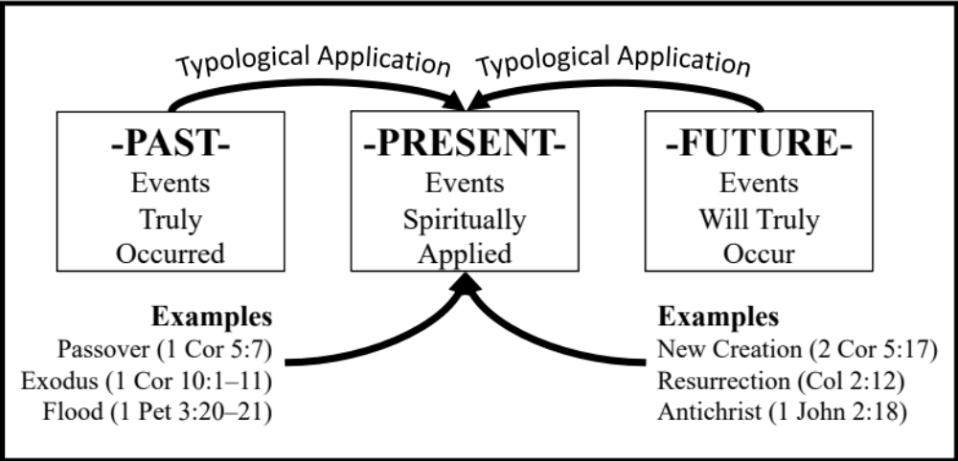
A Hope for Israel in the Early Church?

Slide 31

A Hope for Israel in the Early Church?
“He is ‘exalted at the right hand of God,’ as Peter declares in the Acts; is the Lord of hosts, because all things are by the Father made subject to Him; is the King of Israel because to Him has especially been committed the destiny of that nation.”
Tertullian, Against Praxeas 17
“It will be fitting for the Christian to rejoice, and not to grieve, at the restoration of Israel, if it be true, (as it is), that the whole of our hope is intimately united with the remaining expectation of Israel.”
Tertullian, On Modesty 8.
Tertullian of Carthage c. 200
Notes:
“”

Slide 32
A Hope for Israel in the Early Church?
“To Christ, however, 'the order of Melchizedek’ will be very suitable; for Christ is the proper and legitimate High Priest of God. He is the Pontiff of the priesthood of the uncircumcision, constituted such, even then, for the Gentiles, by whom He was to be more fully received, although at His last coming He will favor with His acceptance and blessing the circumcision also, even the race of Abraham, which by and by is to acknowledge Him.”
Tertullian, Against Marcion 5.9.
Tertullian of Carthage c. 200
Notes:
“”

Slide 33
A Hope for Israel in the Early Church?
“Up to the present moment they have not, tribe by tribe, smitten their breasts, looking on Him whom they pierced. No one has as yet fallen in with Elias; no one has as yet escaped from Antichrist; no one has as yet had to bewail the downfall of Babylon.”
Tertullian, On the Resurrection of the Flesh 22
Tertullian of Carthage c. 200
Notes:
“”

Slide 34
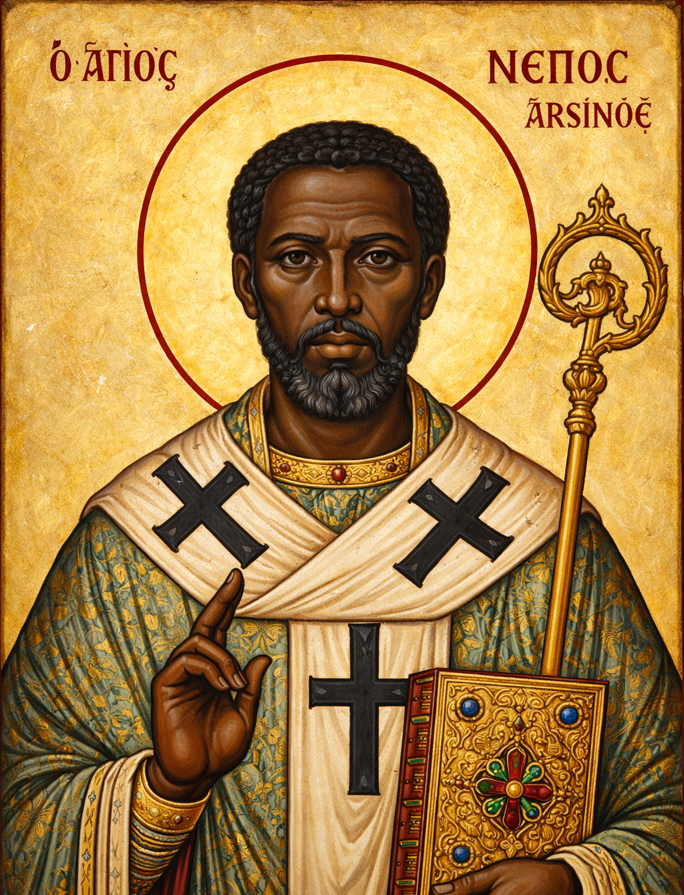
A Hope for Israel in the Early Church?
“The occasion was supplied him [Dionysius of Alexandria] by the teaching of Nepos, a bishop of those in Egypt, that the promises which had been made to the saints in the divine Scriptures should be interpreted after a more Jewish fashion, and his assumption that there will be a kind of millennium on this earth devoted to bodily indulgence. Thinking, for example, to establish his own peculiar opinion from the Apocalypse of John, he composed a certain book on the subject and entitled it Refutation of the Allegorists.”
Eusebius, Ecclesiastical History 7.24.1
Nepos of Arsinoë c. 250
Notes:
“”

Slide 35
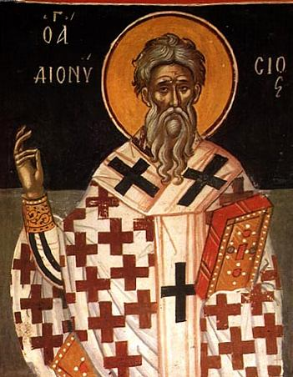
A Hope for Israel in the Early Church?
“Now when I came to the nome of Arsinoë, where, as thou knowest, this doctrine had long been prevalent, so that schisms and defections of whole churches had taken place, I called together the presbyters and teachers of the brethren in the villages (there were present also such of the brethren as wished), and I urged them to hold the examination of the question publicly. And when they brought me this book as some invincible weapon and rampart, I sat with them and for three successive days from morn till night attempted to correct what had been written.”
Dionysius of Alexandria, On Promises, via Ecclesiastical History 7.24.6–7
Dionysius of Alexandria, c. 260
Nepos of Arsinoë c. 250
Notes:
“”

Slide 36
A Hope for Israel in the Early Church?
“For He says by Malachi: ‘Lo, I will send to you Elias the Tishbite, to turn the hearts of the fathers to the children, according to the time of calling, to recall the Jews to the faith of the people that succeed them.’ And to that end He shows, as we have said, that the number of those that shall believe, of the Jews and of the nations, is a great multitude which no man was able to number.”
Victorinus, Commentary on the Apocalypse 7.2
Victorinus of Pettau c. 270
Notes:
“”

Slide 37
A Hope for Israel in the Early Church?
1st Century
2nd Century
3rd Century
Earthly Kingdom &
Restoration of Israel
Earthly Kingdom Centered in Jerusalem
& Subtle Refences to Restoration of Israel
Jewish-Christian Premillennialism
Gentile Christian
Premillennialism
Gentile Christian
Amillennialism
No Earthly Kingdom, No Rebuilding of Jerusalem,
& No Restoration of Israel, though Sometimes a Future Conversion of Jews
Notes:
“”

Slide 38

A Hope for Israel in the Early Church?
“Certain persons, then, refusing the labour of thinking, and adopting a superficial view of the letter of the law…. say that after the resurrection there will be marriages, and the begetting of children, imagining to themselves that the earthly city of Jerusalem is to be rebuilt.… Such are the views of those who, while believing in Christ, understand the divine Scriptures in a sort of Jewish sense.”
—Origen, First Principles 2.11.2
Notes:
“”

Slide 39
A Hope for Israel in the Early Church?
“One fact, then, which proves that Jesus was something divine and sacred, is this, that Jews should have suffered on His account now for a lengthened time calamities of such severity. And we say with confidence that they will never be restored to their former condition. For they committed a crime of the most unhallowed kind, in conspiring against the Saviour of the human race in that city where they offered up to God a worship containing the symbols of mighty mysteries…
Notes:
“”

Slide 40
A Hope for Israel in the Early Church?
“…It accordingly behoved that city where Jesus underwent these sufferings to perish utterly, and the Jewish nation to be overthrown.”
Origen, Against Celsus 4.2.2
Notes:
“”

Slide 41

A Hope for Israel in the Early Church?
“He [Papias] is the one who is said to have promulgated the Jewish tradition of a millennium, and he is followed by Irenaeus, Apollinarius*, and others, who say that after the resurrection the Lord will reign in the flesh with the saints.”
—Jerome, Illustrious Men 18
*That is, Apollinaris of Hierapolis (c. AD 160–180), a disciple of Polycarp. Not to be confused with Apollinaris of Laeodicaea, the instigator of the heresy of Apollinarianism.
Notes:
“”

Slide 42
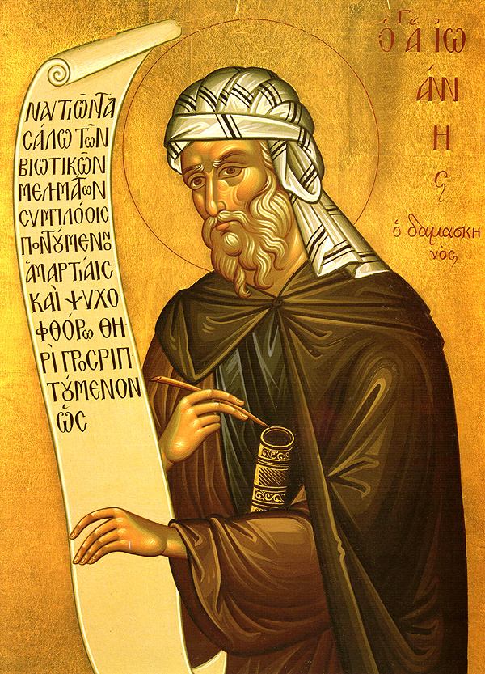
A Hope for Israel in the Early Church?
“But Enoch and Elias the Thesbite shall be sent and shall turn the hearts of the fathers to the children, that is, the synagogue to our Lord Jesus Christ and the preaching of the apostles: and they will be destroyed by him [the Antichrist].”
John of Damascus, Exposition of the Orthodox Faith 4.26
John of Damascus, c. 675-749
Notes:
“”

Slide 43
A Hope for Israel in the Early Church?
1st Century
2nd Century
3rd Century
Earthly Kingdom &
Restoration of Israel
Earthly Kingdom Centered in Jerusalem
& Subtle Refences to Restoration of Israel
Jewish-Christian Premillennialism
Gentile Christian
Premillennialism
Gentile Christian
Amillennialism
No Earthly Kingdom, No Rebuilding of Jerusalem,
& No Restoration of Israel, though Sometimes a Future Conversion of Jews
Notes:
“”

Slide 44
A Hope for Israel in the Early Church?
fathersonthefuture.com/resources/
Notes:
“”

Slide 45
A Hope for Israel in the Early Church?
Notes:
“”

