Slide 1
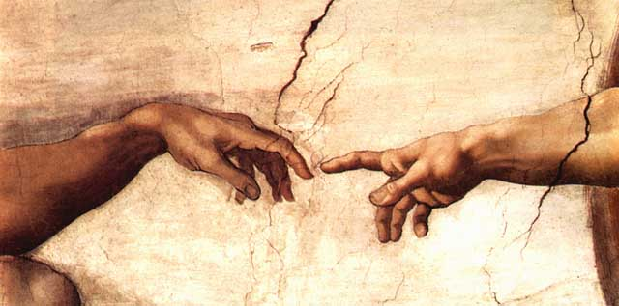

Slide 2
“In the Image
of God…”
The Imago Dei
in Biblical, Theological,
and Practical Perspective
Michael J. Svigel
Dallas Theological Seminary

Slide 3
The Imago Dei

Slide 4
“In the Image of God…”
What is the Imago Dei?
²⁶Then God said, “Let us make humans in our image, according to our likeness….”
²⁷So God created humans in his image, in the image of God he created them; male and female he created them.
(Gen 1:26, 27)

Slide 5
“In the Image of God…”
What is the Imago Dei?
¹…When God created humans, he made them in the likeness of God. ²Male and female he created them…. ³When Adam had lived one hundred thirty years, he became the father of a son in his likeness, according to his image, and named him Seth.
(Gen 5:1–3)

Slide 6
“In the Image of God…”
What is the Imago Dei?
⁶Whoever sheds the blood of a human, by a human shall that person’s blood be shed, for in his own image God made humans.
(Gen 9:6)

Slide 7
“In the Image of God…”
What is the Imago Dei?
⁹With it [the tongue] we bless the Lord and Father, and with it we curse people, made in the likeness of God.
(James 3:9)

Slide 8
“In the Image of God…”
Angelic (Heavenly)
Beings
(non-angelic)
Human Beings
(non-animal)
Animal
(Earthly) Beings

Slide 9
“In the Image of God…”
What is the Imago Dei?
A Biblical-Theological Understanding of the Image of God Must:
Include the full person—body, soul, spirit, mind, emotion, will.
Apply to individuals and communities, male and female in every generation, in unity and diversity.
Exhibit aspects retained after the Fall—though damaged and distorted.

Slide 10
“In the Image of God…”
What is the Imago Dei?
A Biblical-Theological Understanding of the Image of God Must:
Involve the dynamic capacity for growth in conformity to Christ—the Image of God.
Elevate the inherent value and uncompromised dignity of persons and communities.
Advance human life and flourishing—both individually and corporately.

Slide 11
“In the Image of God…”
What is the Imago Dei?
Substantial View—The Imago Dei is a static, essential quality of humans.
Relational View—The Imago Dei is a dynamic, relational aspect of humans.
Christological View—The Imago Dei is a reflection of the ideal Image of God—Christ.
Functional View—The Imago Dei is active, a purpose or function we fulfill.

Slide 12
“In the Image of God…”
Substantial View of Imago Dei
Also called the “structural” view.
What we are in our essence or nature.
Sometimes tied to spiritual, intellectual, moral, or rational capacity.
Often neglects our physical, bodily nature.
Sometimes emphasizes individuals as bearing or being the image of God.

Slide 13
“In the Image of God…”
Relational View of Imago Dei
Emphasizes community and relationships.
Explains the relational implications of “Let us make humans…” (Gen 1:26)
Explains the male-female relationship in terms of unity in community.
Could downplay the value and dignity of each individual.

Slide 14
“In the Image of God…”
Christological View of Imago Dei
Emphasizes Jesus Christ as the Image of God par excellence.
Reads Gen 1:26–27 christologically—humans created according to the future pattern of Christ, the perfect human.
May devalue non-redeemed humans who are not being conformed toward Christ-likeness.

Slide 15
“In the Image of God…”
Functional View of Imago Dei
Accommodates the substantial, relational, and Christological views.
Emphasizes the mission for which humans were created and blessed.
Allows for partial, imperfect reflection of the Imago Dei as the mission is imperfectly and partially fulfilled.
Anticipates a complete future fulfillment.

Slide 16
“In the Image of God…”
Functional View
The Imago Dei Mission
Substantial | Christological | Relational

Slide 17
The Imago Dei Mission

Slide 18
“In the Image of God…”
What Is the Imago Dei Mission?
God’s original plan for humanity was the fulfillment of the Imago Dei Mission.

Slide 19
“In the Image of God…”
What Is the Imago Dei Mission?
Then God said, “Let us make humans in our image, according to our likeness, and let them have dominion over the fish of the sea and over the birds of the air and over the cattle and over all the wild animals of the earth and over every creeping thing that creeps upon the earth.”
(Gen 1:26)

Slide 20
“In the Image of God…”
What Is the Imago Dei Mission?
God blessed them, and God said to them, “Be fruitful and multiply and fill the earth and subdue it and have dominion over the fish of the sea and over the birds of the air and over every living thing that moves upon the earth.”
(Gen 1:28)

Slide 21
“In the Image of God…”
What Is the Imago Dei Mission?
“As humanity fulfilled its instruction to multi-ply and fill the earth, this blessing would move forward to spill out beyond the borders of the garden of Eden to the rest of the earth as well. In so doing, they will need to subdue the land that is outside of the garden so that it becomes like the land that is within the boundaries of the garden.”
Paul Krüger and Matthew Haynes, “Creation Rest: Genesis 2:1–3 and the First Creation Account,” Old Testament Essays 30.3 (2017): 680.

Slide 22
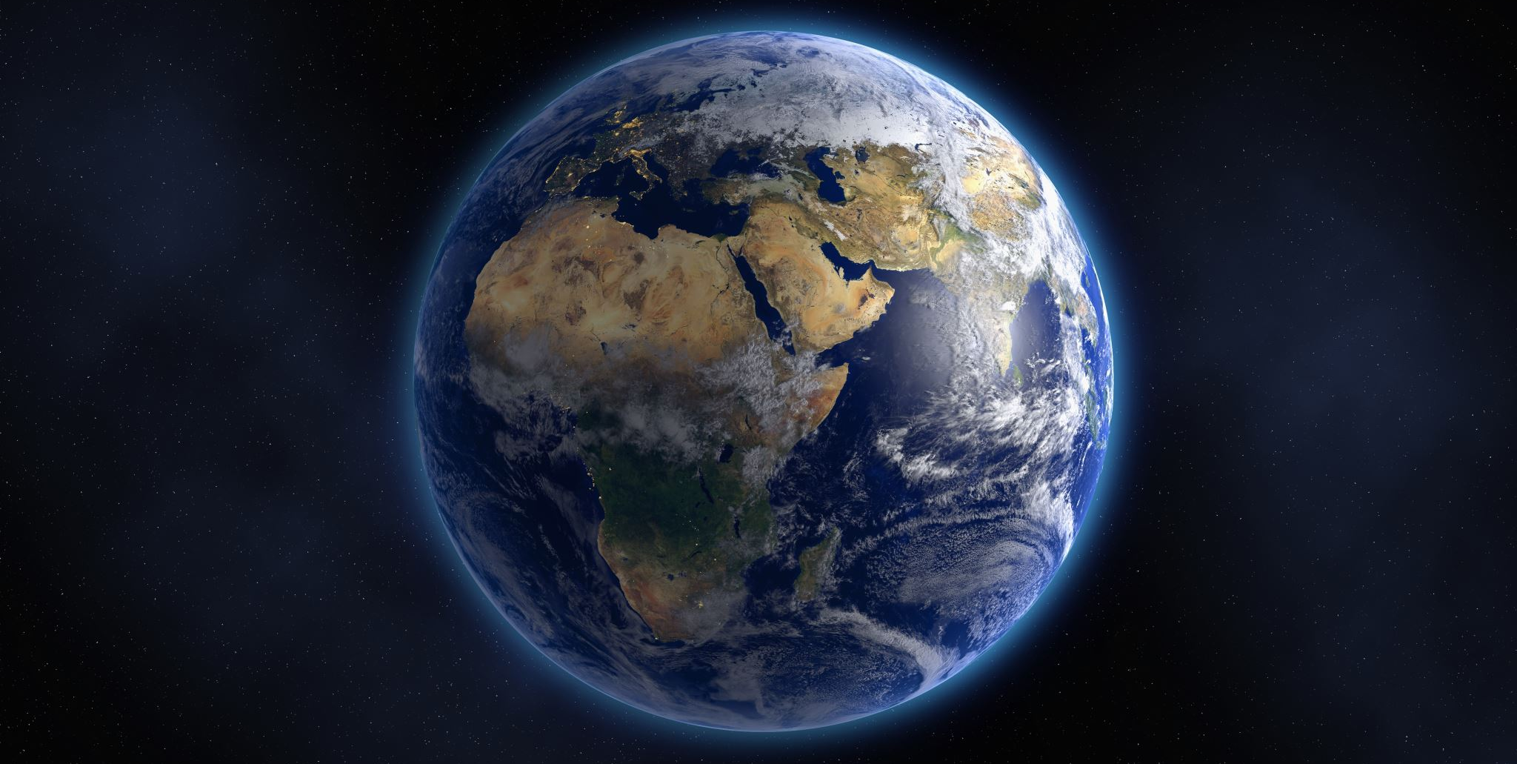

Slide 33
“In the Image of God…”
What Is the Imago Dei Mission?
God’s original plan for humanity was the fulfillment of the Imago Dei Mission.
The Fall postponed God’s plan, but it did not cancel it . . . and God has no Plan B.

Slide 35
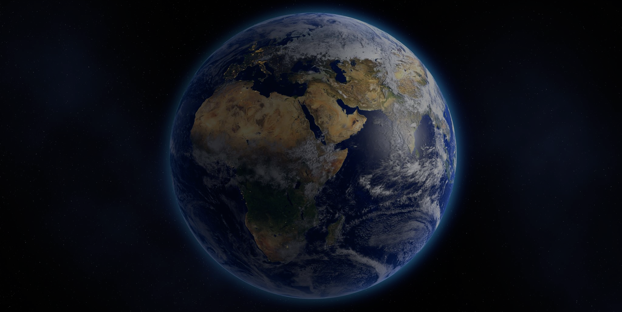

Slide 36
“In the Image of God…”
What Is the Imago Dei Mission?
God’s original plan for humanity was the fulfillment of the Imago Dei Mission.
The Fall postponed God’s plan, but it did not cancel it . . . and God has no Plan B.
In the future, Christ will fulfill the Imago Dei Mission: the conformity of creation to the likeness of heaven on earth.

Slide 50
“In the Image of God…”
What Is the Imago Dei Mission?
God’s original plan for humanity was the fulfillment of the Imago Dei Mission.
The Fall postponed God’s plan, but it did not cancel it . . . and God has no Plan B.
In the future, Christ will fulfill the Imago Dei Mission: the conformity of creation to the likeness of heaven on earth.
This full realization of the Kingdom of God can be partially fulfilled today.

Slide 51
The Kingdom of God

Slide 52
“In the Image of God…”
What Is the Kingdom of God?
“Our Father, who is in heaven,
Hallowed be Your name.
Your kingdom come.
Your will be done,
On earth as it is in heaven.”
(Matthew 6:10)

Slide 53
“In the Image of God…”
What Is the Kingdom of God?
God’s Kingdom
=
God’s will be being done,
on earth as it is in heaven
=
Fulfilling the Imago Dei Mission

Slide 54
“In the Image of God…”
What Is the Kingdom of God?
Presently realized spiritually in the heavenly realm
Progressively realized when Christ returns and begins transforming this world
Perfectly realized when the whole creation is delivered from bondage
Partially realized when individuals, communities, nations conform to God’s will

Slide 55
PARADISE
Presently realized spiritually in the heavenly realm—Paradise.
THIS OLD CREATION

Slide 56
Progressively realized when Christ returns and begins transforming this world
FUTURE
RENEWAL
OF CREATION
THIS OLD CREATION

Slide 57
Perfectly realized when all creation is delivered from bondage to corruption
RENEWED CREATION—
“THE NEW HEAVENS AND NEW EARTH”—
PARADISE
ON EARTH

Slide 58
Partially realized when individuals, communities, and nations conform to God’s will
THIS OLD CREATION

Slide 59
Living out the
Imago Dei Mission

Slide 60
“In the Image of God…”
Living Out the Imago Dei Mission
God created each of us in unique ways to partially fulfill the Imago Dei Mission—manifesting God’s kingdom by doing God’s will in the world—i.e., living out the virtues, values, principles, and priorities of God’s Kingdom.
God called all of us to unity and community as we partially fulfill the Imago Dei Mission together as the people of God.

Slide 61
“In the Image of God…”
Living Out the Imago Dei Mission
Today, we have everything we need—from our human nature to God’s blessing—to carry out the Imago Dei Mission in whatever sphere God has placed us.
This Imago Dei Mission is for men and women, and the only qualification to participate is to be human.

Slide 62
“In the Image
of God…”
The Imago Dei
in Biblical, Theological,
and Practical Perspective
Michael J. Svigel
Dallas Theological Seminary

Slide 63
“In the Image of God…”
Discussion/Application Questions
Define “the Image of God” (Imago Dei).
What are the four major views on the Imago Dei?
What is the key passage establishing the Imago Dei? Other supporting passages?

Slide 64
“In the Image of God…”
Discussion/Application Questions
How does understanding Christ as THE Image of God par excellence help us explain what it means for us to be created in and conformed to the Image of God?
Define “the Imago Dei Mission.” How is this related to the Kingdom of God?
Define “the Kingdom of God.”

Slide 65
“In the Image of God…”
Discussion/Application Questions
What realms of your world today need ordering, filling, or subduing (personal, mental, emotional, relational, spiritual, physical, etc.?)
If your everyday attitudes and actions were to better reflect the virtues, values, principles, and priorities of God’s Kingdom, what would need to change?

Slide 66
“In the Image of God…”
Discussion/Application Questions
Who in your life is helping you pursue Christ’s character or carry out God’s will? In what ways? How can you better partner with that person?
Who in your life may be hindering you from pursuing Christ’s character and from carrying out God’s will? In what ways? What can you do to make that relationship more redemptive?

